Slide 1

Evaluation of
Antimicrobial Stewardship (AMS) and Microbiological Surveillance at JOOTRH Pediatric Hospital:
Strengthening a Culture of Culturing.
September 2025

Slide 2
Background
GENERAL
JOOTRH
Antimicrobial resistance (AMR) is a growing global threat
The burden is especially high in low- and middle-income countries (LMICs).
Resistance data in LMICs remain limited, hindering comprehensive Antimicrobial Stewardship.
Culture of culturing not prominent
Culture capture in 2024 was only 364 cultures for the Newborn Unit (NBU) and Pediatric wards combined.
Utilization of antibiotics using AWaRE categorization across the hospital was higher than desired from the WATCH antibiotic category.
Notes:
Despite an average daily census of approx.
60/patients/day in NBU
55/patients/day in Pediatrics

Slide 3
Objectives:
Primary objective:
  Through increased microbiological surveillance, develop an antibiogram
Secondary objective:
  Increase Antimicrobial Stewardship (AMS) initiatives

Slide 4
Study parameters
Time period:
  January 2025 to June 2025; (study still ongoing)
Inclusion criteria:
  Children aged 0 to 12 years old
  Admitted to Newborn Unit (NBU) or Obama Children's Hospital and indication for microbiology testing
Culture specimens:
  blood, CSF, urine, stool or other body fluids
Quantitative assessment of antibiotic utilization at JOOTRH

Slide 5
Data analytics:
Mixed methods qualitative and quantitative design
Descriptive assessment of baseline characteristics and clinical infection data.
Antibiogram development in accordance with CLSI guidelines
Notes:
Descriptive assessment data not available yet, analysis ongoing

Slide 6
Methods-Outcome: Primary Objective
Outcome
Methods
Methods | Status update
Laboratory capacity building | Collaborated with Balance study researchers | Obtained 2 grants to aid in the support of laboratory supply sustainability | Ongoing grant funding initiatives in place JOOTRH National Level 6 status will also firm up sustainability
Resource deployment to wards | Have two phlebotomists/microbiologists deployed to the NBU and Pediatric wards. This has dramatically increased culture capture.
Increased timelines of reporting + blood cultures results | With utilization of the phlebotomist, they report out daily to the team, if and when cultures turn +.
Increase culture capture (surveillance) through:
  Ensuring adequate laboratory supply availability with funding and collaborations
  Increased resource deployment to the wards
  Enhance surveillance and reporting
Antibiogram development
  Creation in accordance with the CLSI laboratory standards
Notes:
Despite an average daily census of approx.
60/patients/day in NBU
55/patients/day in Pediatrics

Slide 7
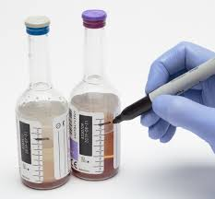
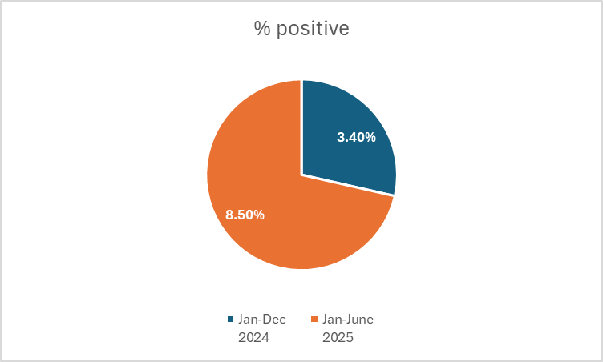
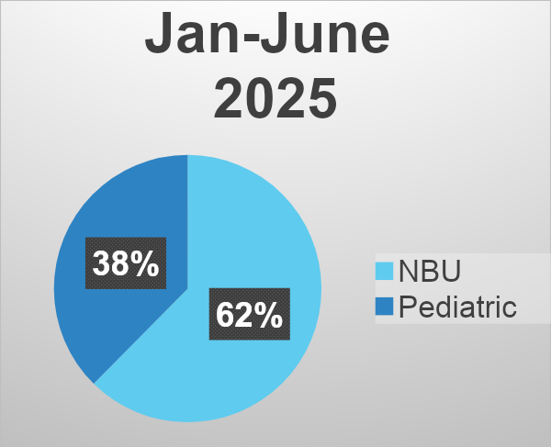
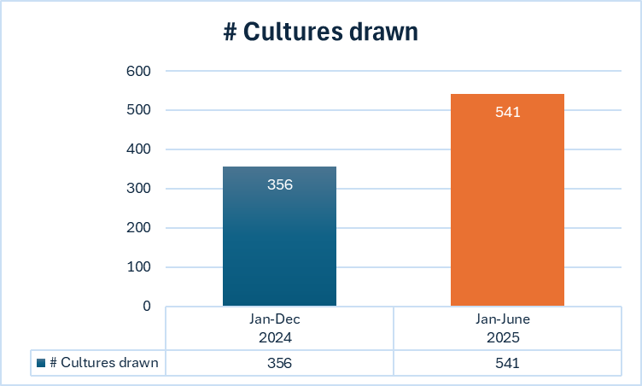
Primary Objective - Outcome
Microbiological Surveillance
51.9% increase in 1st 6 months
Notes:
this slide or next - decide which you like and delete the other :)

Slide 8
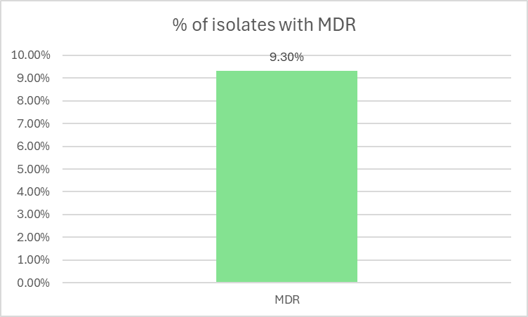
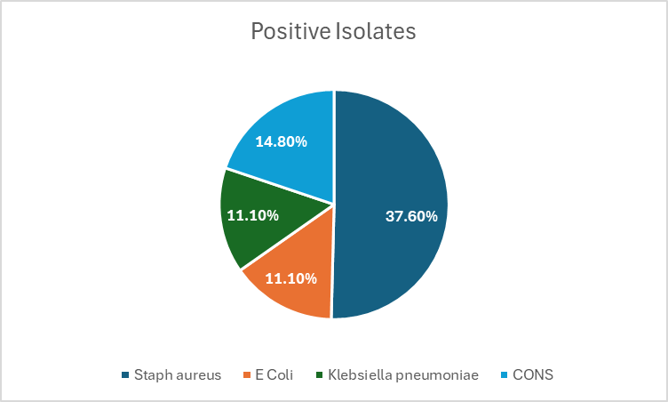
Primary Objective - Outcome
Microbiological Surveillance cont.
Notes:
Comment about:
- determination of clinical significance of CONS
specify what organisms fall under MDR

Slide 9
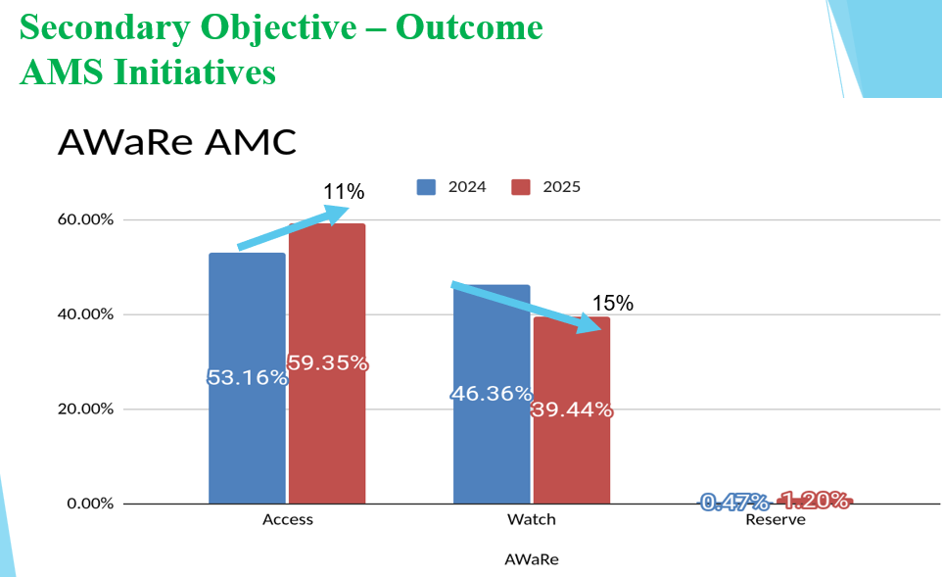
Methods and Outcome: Secondary Objective
Increase Antimicrobial Stewardship (AMS) initiatives
  Orientation educational session with each new year of interns
  Periodic staff educational sessions on AMS initiatives and AMR issues
  Educational instruction on daily ward rounds
  Increase focus on Infection Prevention and Control (IPC) initiatives
    Increase utilization of IPC nurse daily compliance checks
    Develop reserve antibiotics policy
    Increase Clinical Pharmacists follow-up antibiotic streamlining post culture.
Educational sessions
Methods | Status update
Educational sessions | August 2024 presentation to new Coi/MOI and house staff | December 2024 Presentation of Dr Nanjala’s project | August 2024-June 2025 Daily education on ward rounds with Pediatrician and/or Clinical pharmacists

Slide 10
Conclusion
Primary objective achievements:
  Our efforts have increased culture capture
  Reporting of + Blood cultures in a timely manner has increased
  We are seeing incidence of MDR isolates
  Antibiogram development underway, with plans for completion by years end.
  Secondary objective achievements:
  Educational efforts have increased awareness but more consistent sessions needed.
  Consideration for mandatory competency about AMS and AMR for staff need to be incorporated.
  AMS and Clinical Pharmacists policies on antibiotic restriction has improved antibiotic utilization.

Slide 11
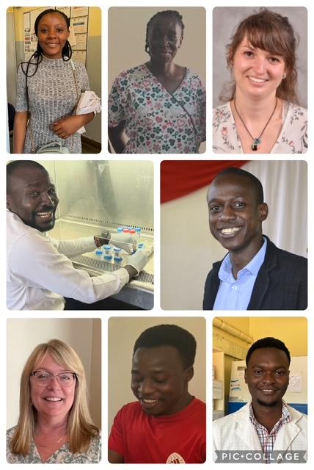





Interprofessional and International Team Members
No disclosures or conflicts.
Name | Profession | Affiliation
Dr Rachel Nanjala | Pediatric Resident
Dr Lucia Janovic | Pediatrician Attending/Consultant
Dr. Silas Awuor Dr Neto Obala Miss Syvia Odour Mr Wills Owino Dr Gilack Odingo | Medical Microbiologist Clinical Pharmacist Phlebotomist /Microbiologist Phlebotomist /Microbiologist Pharmacist
Dr Lisa Phillips | Clinical Pharmacist
Notes:
maybe we can move this to the end? or at minimum assure precious time is not spent on it other than efforts wwe interprofessional and international.

Slide 12
Thank you.
QUESTIONS?
Acknowledgement:

